Slide 1

Mesterséges Intelligencia
IoT, Power BI integráció példák

Slide 2
Azure Cognitive Services használata Power BI-ban
Notes:
A Power BI jelenleg az alábbi Azure Cognitive Services szolgáltatásokat támogatja: Hangulatelemzés, Kulcsszókeresés, Nyelvfelismerés és Képcímkézés.

Slide 3
Szövegelemzés
Vélemények értékelése az alábbi (FabrikamComments.csv) adatforrás használatával:
id | inreplyto | name | userid | emailaddress | datetime | topic | subject | comment | spamscore | votes
1102 | 0 | Donald Erie | derie | don@example.com | 9:04:00 | shipping | Insufficient packaging | I ordered three widgets last week and just received them. I am VERY disappointed in the way they were packed. The box was only about two thirds full of packing peanuts and the widgets were not individually wrapped. As a result they were able to bump up against each other while in transit. The display on one doesn't work at all and the other two are quite scratched up (look like they have been in service for years) though they do work fine. I have always been satisifed with your service and trust you will make this right, but I suggest you look into how you are packing these items. You will have a lot of unhappy customers otherwise. | 10 | 3
1103 | 0 | Jake Bering | jakeb | jake.bering@example.com | 9:37:00 | fulfillment | Wrong items again | Can't believe you fools shipped me the wrong items AGAIN. If you weren't the only company I've been able to find that even has these items, I would have stopped ordering from you a long time ago. I order weekly and it seems like at least once a month my order has some kind of foul-up. Waiting for the order to be corrected would set my business back so I need to keep extra on hand just in case. Not fair for me to have to carry extra inventory to make up for YOUR screw-ups! Hire someone who can tell the difference between a thingamabob and a whatchamacallit. If anyone reading this knows of another source please let me know. | 5 | 10
1104 | 0 | Ann Huron | annh | ahuron@example.com | 10:11:00 | praise | Fantastic! | Wow! I had NO IDEA that reciprocating garombles of such high quality even existed! And they're a steal, too; I've paid twice your asking price for garombles that weren't nearly as smooth in operation. Free ground delivery was a plus (the overnight shipping seems a little spendy though). We'll see how these actually hold up, but so far I'm sold! | 15 | 2
1105 | 1103 | David Columbia | davidc | davidc78@example.com | 10:15:00 | fulfillment | Re: Wrong items again | Jake, I've had similar problems tracking down another source of thingamabobs. (Or is it whatchamacallits you need?) I have found Contoso Supply to have thingamabobs but not reliably. Maybe if they started getting more orders for them this would improve. | 5 | 0
Notes:
A feladat végrehajtásához prémium Power BI account szükséges, amit oktatási intézmények időkorlátosan tudnak igényelni.

Slide 4
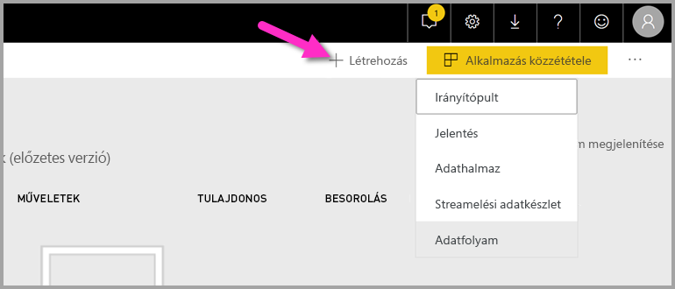
Adatforráshoz új projekt létrehozása

Slide 5
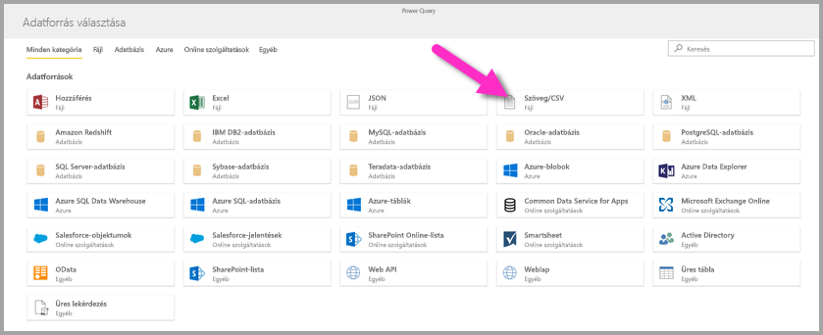
Adatforrás
Új entitások hozzáadása / az adatforrások menüjében a Szöveg/CSV elem:

Slide 6
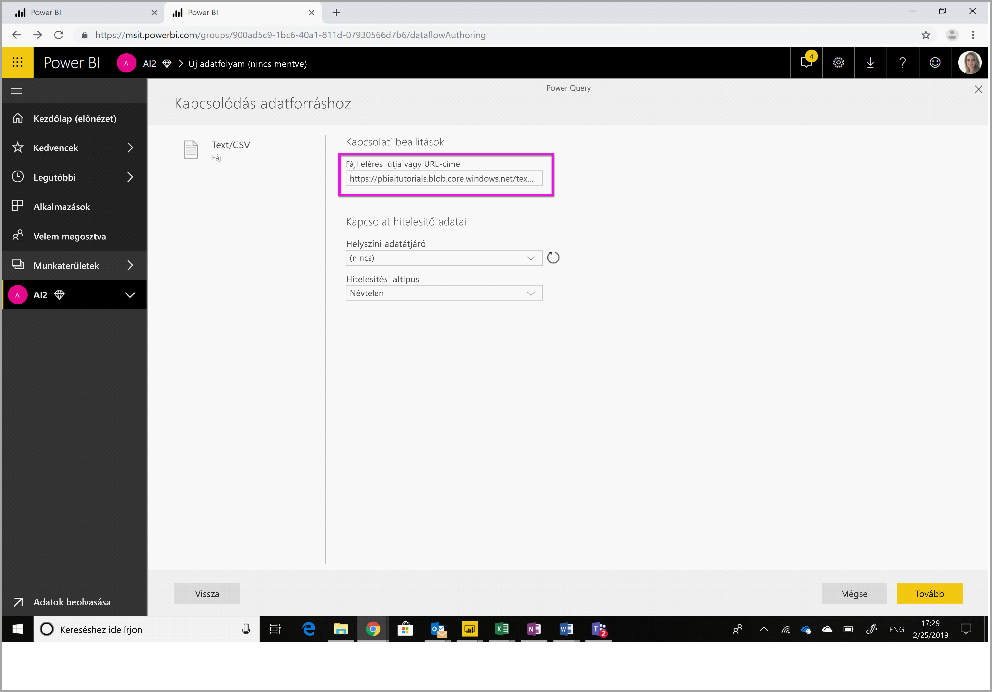
Adatforrás megadása
Tábla átalakítása majd az Első sor használata fejlécként elemet kiválasztva folytassuk

Slide 7
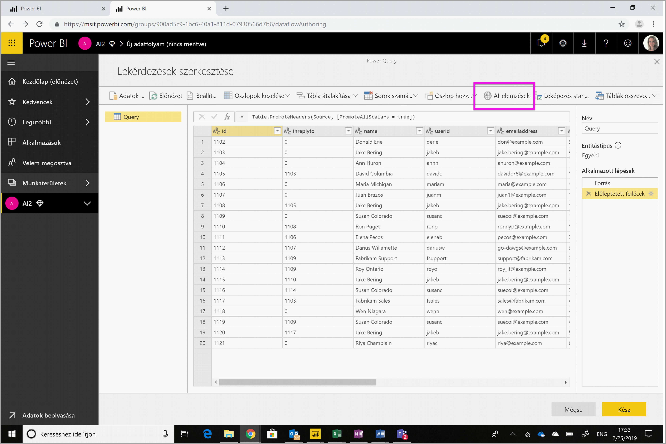
AI elemzés megadása
Power Query-szerkesztőben válasszuk az AI-elemzések lehetőséget.

Slide 8
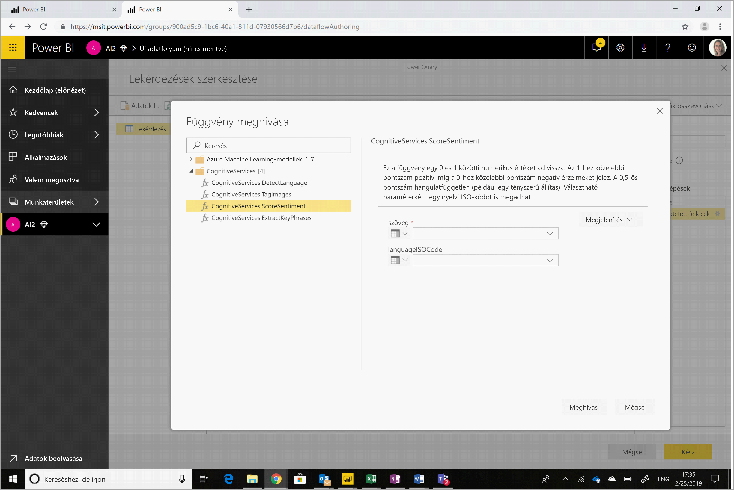
Cognitive Services beállítása
A Cognitive Services mappában tudjuk a szükséges függvényt kiválasztani, ami esetünkben a CognitiveSentiments.ScoreSentiment

Slide 9
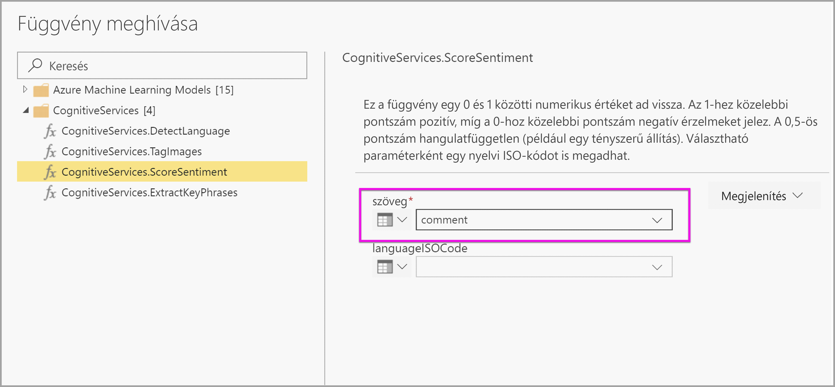
Függvény paraméterezése

Slide 10
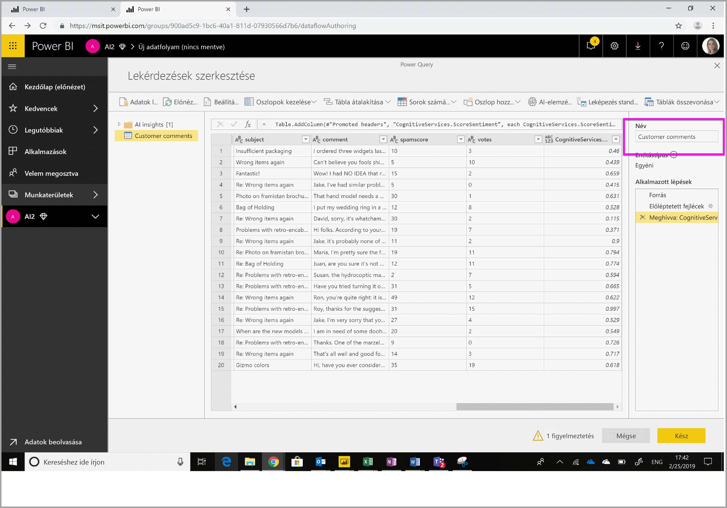
Eredmény megtekintése: AI elemzések – AI Insights

Slide 11
IoT szenzorok feldolgozása, Power BI integráció

Slide 12
Szenzor adatok feldolgozása
Komponensek:
TI SensorTag
Azure Account
EventHub
ASA – Azure Stream Analytics Service
Power BI

Slide 13
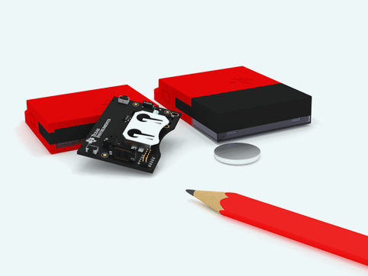
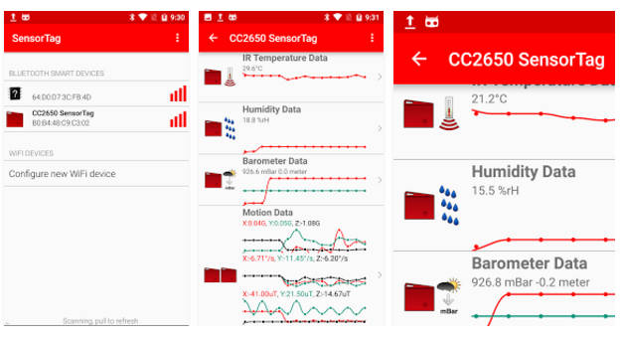
SensorTag (BLE 4.0)
Hőmérséklet, páratartalom, fényerő, giroszkóp, nyomógomb, magnetométer/iránytű, légnyomás
iBeacon
Bluetooth 4.0
https://play.google.com/store/apps/details?id=com.ti.ble.sensortag
https://itunes.apple.com/app/ti-sensortag/id552918064

Slide 14
Azure EventHub
Beállítási segédlet: https://docs.microsoft.com/hu-hu/azure/event-hubs/event-hubs-dotnet-standard-getstarted-send
Beállításokhoz: SensorEventGenerator
<appSettings> <add key="SBNameSpace" value="your service bus namespace" />
<add key="EHName" value="your event hub name" />
<add key="AccessPolicyName" value="name of policy having manage permission" />
<add key="AccessPolicyKey" value="your key" />
<add key="SensorName" value="any displaay name you want to give your sensor" />
</appSettings>

Slide 15
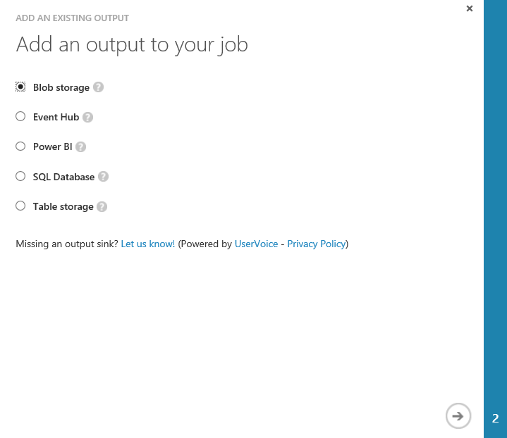
Azure Stream Analytics adatforrás – output tab

Slide 16
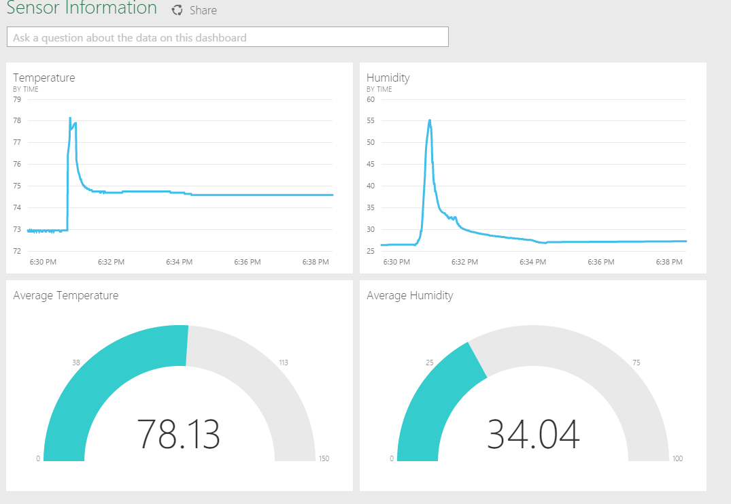
Power BI
Querry job:
SELECT max(hmdt) as hmdt , max(temp) as temp , time , 0 as minTemp , 150 as maxTemp , 75 as targetTemp , 100 as maxHmdt , 70 as targetHmdt FROM Input
GROUP BY TUMBLINGWINDOW(ss,1) ,time ,dspl

Slide 17
Köszönöm a figyelmet!

